Slide 1

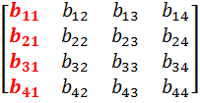
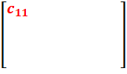
Strassen’s Algorithm
A fundamental numerical operation is the multiplication of 2 matrices.
The standard method of matrix multiplication of two n x n matrices takes T(n) = O(n³).
X
=
The following algorithm multiples n x n matrices A and B:
// Initialize C.
for i = 1 to n
for j = 1 to n
for k = 1 to n
C [i, j] += A[i, k] * B[k, j];

Slide 2

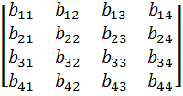

Strassen’s Algorithm
We can use a Divide and Conquer solution to solve matrix multiplication by separating a matrix into 4 quadrants:
X
=
Then we know have:
if
, then we have the following:
8 n/2 * n/2 matrix multiples + 4 n/2 * n/2 matrix additions
T(n) = 8T(n/2) + O(n²)
If we solve using the master theorem we still have O(n³)

Slide 3
Strassen’s Algorithm
Strassen showed how two matrices can be multiplied using only 7 multiplications and 18 additions:
Consider calculating the following 7 products:
P = (a₁₁ + a₂₂) * (b₁₁ + b₂₂)
Q = (a₂₁ + a₂₂) * b₁₁
R = a₁₁*( b₁₂ – b₂₂)
S = a₂₂ * (b₂₁ – b₁₁)
T = (a₁₁ + a₁₂) * b₂₂
U = (a₂₁ – a₁₁) * (b₁₁ + b₁₂)
V = (a₁₂ – a₂₂) * (b₂₁ + b₂₂)
It turns out that
c₁₁ = P + S – T + V
c₁₂ = R + T
c₂₁ = Q + S
c₂₂ = P + R – Q + U

Slide 4
Strassen’s Algorithm
 | Mult | Add | Recurrence Relation | Runtime
Regular | 8 | 4 | T(n) = 8T(n/2) + O(n²) | O(n³)
Strassen | 7 | 18 | T(n) = 7T(n/2) + O(n²) | O(n ^{log27}) = O(n^{2.81})
Fastest known method is O(n^{2.3727}) [Winograd-Coppersmith algorithm improved by V. Williams]

Slide 5
Strassen’s Algorithm
I have no idea how Strassen came up with these combinations.
He probably realized that he wanted to determine each element in the product using less than 8 multiplications.
From there, he probably just played around with it.
If we let T(n) be the running time of Strassen's algorithm, then it satisfies the following recurrence relation:
T(n) = 7T(n/2) + O(n²)
It's important to note that the hidden constant in the O(n²) term is larger than the corresponding constant for the standard divide and conquer algorithm for this problem.
However, for large matrices this algorithm yields an improvement over the standard one with respect to time.

Slide 6
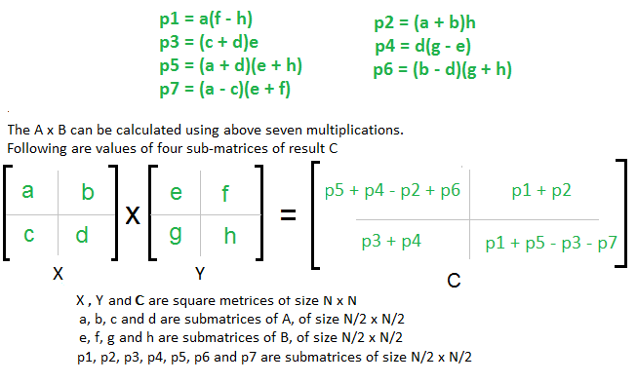
Easy way to remember Strassen’s Matrix Equation

Slide 7
Easy way to remember Strassen’s Matrix Equation
You just need to remember 4 Rules :
AHED (Learn it as ‘Ahead’)
Diagonal
Last CR
First CR
Also, consider X as (Row +) and Y as (Column -) matrix

Slide 8
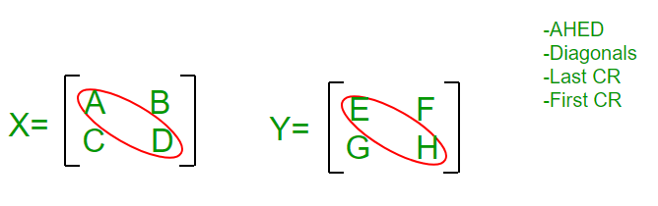
Easy way to remember Strassen’s Matrix Equation
Follow the Steps :
Write P1 = A; P2 = H; P3 = E; P4 = D
For P5 we will use Diagonal Rule i.e. (Sum the Diagonal Elements Of Matrix X ) * (Sum the Diagonal Elements Of Matrix Y ), we get P5 = (A + D)* (E + H)

Slide 9
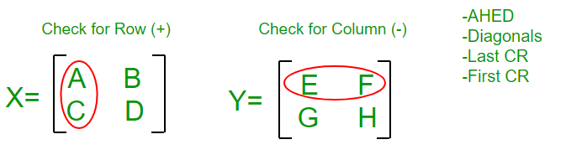
Easy way to remember Strassen’s Matrix Equation
P1 = A P2= H P3= E P4= D P5= ( A + D ) * ( E + H )
For P6 we will use Last CR Rule i.e. Last Column of X and Last Row of Y and remember that Row+ and Column- so i.e. (B – D) * (G + H), we get P6 = (B – D) * (G + H)
For P7 we will use First CR Rule i.e. First Column of X and First Row of Y and remember that Row+ and Column- so i.e. (A – C) * (E + F), we get P7 = (A – C) * (E + F)

Slide 10
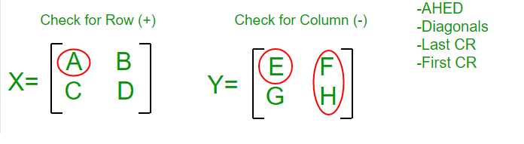
Easy way to remember Strassen’s Matrix Equation
P1 = A P2= H ; P3= E; P4= D P5= ( A + D ) * ( E + H ) P6= ( B – D ) * ( G + H) P7= ( A – C ) * ( E + F)
Come Back to P1 : we have A there and it’s adjacent element in Y Matrix is E, since Y is Column Matrix so we select a column in Y such that E won’t come, we find F H Column, so multiply A with (F – H) So, finally P1 = A * (F – H)

Slide 11
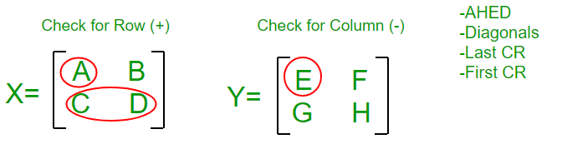
Easy way to remember Strassen’s Matrix Equation
P1 = A * ( F – H) P2= H P3= E; P4= D P5= ( A + D ) * ( E + H ) P6= ( B – D ) * ( G + H) P7= ( A – C ) * ( E + F)
Come Back to P2 : we have H there and it’s adjacent element in X Matrix is D, since X is Row Matrix so we select a Row in X such that D won’t come, we find A B Column, so multiply H with (A + B) So, finally P2 = (A + B) * H

Slide 12
Easy way to remember Strassen’s Matrix Equation
P1 = A * ( F – H) P2= = (A + B) * H
P3= E P4= D P5= ( A + D ) * ( E + H ) P6= ( B – D ) * ( G + H) P7= ( A – C ) * ( E + F)
Come Back to P3 : we have E there and it’s adjacent element in X Matrix is A, since X is Row Matrix so we select a Row in X such that A won’t come, we find C D Column, so multiply E with (C + D) So, finally P3 = (C + D) * E

Slide 13
Easy way to remember Strassen’s Matrix Equation
P1= A * ( F – H ); P2= H * ( A + B ); P3= E * ( C + D ) P4= D P5= ( A + D ) * ( E + H ) P6= ( B – D ) * ( G + H) P7= ( A – C ) * ( E + F)
Come Back to P4 : we have D there and it’s adjacent element in Y Matrix is H, since Y is Column Matrix so we select a column in Y such that H won’t come, we find G E Column, so multiply D with (G – E) So, finally P4 = D * (G – E)

Slide 14
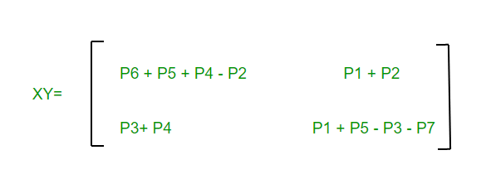
Easy way to remember Strassen’s Matrix Equation
We are done with P1 – P7 equations, so now we move to C1 – C4 equations in Final Matrix C :
Remember Counting : Write P1 + P2 at C2
Write P3 + P4 at its diagonal Position i.e. at C3
Write P4 + P5 + P6 at 1st position and subtract P2 i.e. C1 = P4 + P5 + P6 – P2
Write odd values at last Position with alternating – and + sign i.e. P1 P3 P5 P7 becomes C4 = P1 – P3 + P5 – P7

Slide 15

Example(2 *2)
A = $\left[\begin{matrix}1 & 3 \\ 7 & 5\end{matrix}\right]$ B = $\left[\begin{matrix}6 & 8 \\ 4 & 2\end{matrix}\right]$
C = A * B

Slide 16

Example(2 *2)
A = $\left[\begin{matrix}1 & 3 \\ 7 & 5\end{matrix}\right]$ B = $\left[\begin{matrix}6 & 8 \\ 4 & 2\end{matrix}\right]$
C = A * B
C = $\left[\begin{matrix}18 & 14 \\ 62 & 66\end{matrix}\right]$

Slide 17
Example(2 *2)
a11 = 1 (a)
a12 = 3 (b)
a21 = 7 (c)
a22 = 5 (d)
b11 = 6 (e)
b12 = 8 (f)
b21 = 4 (g)
b22 = 2 (h)

Slide 18
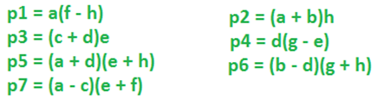
Example(2 *2)
P1 = 6
p2 = 8
p3 = 72
p4 = -10
p5 = 48
p6 = -12
p7 = -84
a11 = 1 (a)
a12 = 3 (b)
a21 = 7 (c)
a22 = 5 (d)
b11 = 6 (e)
b12 = 8 (f)
b21 = 4 (g)
b22 = 2 (h)

Slide 19

Example(2 *2)
c11 = p5 + p4 - p2 + p6 // 18 c12 = p1 + p2 // 14
c21 = p3 + p4 // 62
c22 = p5 + p1 - p3 - p7 // 66
C = $\left[\begin{matrix}18 & 14 \\ 62 & 66\end{matrix}\right]$

Slide 20
Example (3 *3)

